Slide 1
Software Engineering and Architecture
Test Spy Revisited
Unit Testing Strategies

Slide 2
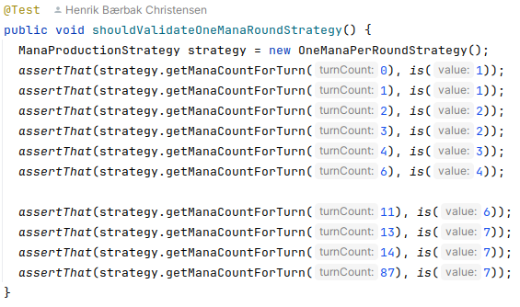
Problem Statement
Some strategies can be Unit Tested
My ‘ManaProductionStrategy’ does not depend upon any HotStone abstraction
So I can unit test it: in isolation from other objects…

Slide 3
Problem Statement
GammaStone was a problem – no Unit Testing possible of the Hero Power Strategy
It modifies the game object ala reducing health of hero by two…
… which of course require us to have a game object in place
Ala an integration test case like
GIVEN a GammaStone Game
WHEN I ask Thai Hero (Findus) to ‘use your power’
THEN game.getHero().getHealth() is reduced by 2
Integration test because
Both Game and Hero Power Strategy (and Hero?) involved…

Slide 4
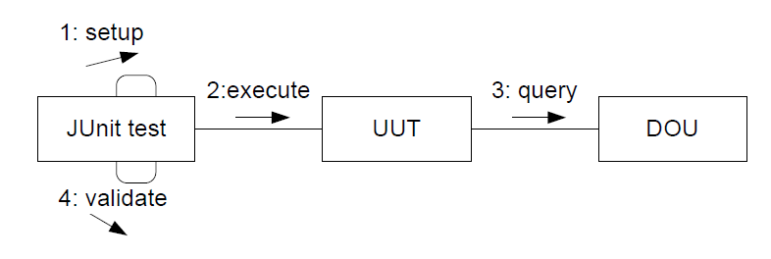
Analysis
Seen from the perspective of the hero power strategy
The usePower() method mutates a Depended Upon Unit (DOU)
Spies serve commands (mutators) by the UUT
Spies are recorders of interaction
So JUnit test can later query the spy about “what happened?”
command
What was sent to the DOU?

Slide 5
Analysis
A Double/Spy is a replacement of the original DOU
Which requires that the DOU is defined by an interface/role
Now our private interface for Game allows us to do unit testing! Replace MutableGame by a spy
usePower
MutableGame
changeHealth
Record the call

Slide 6
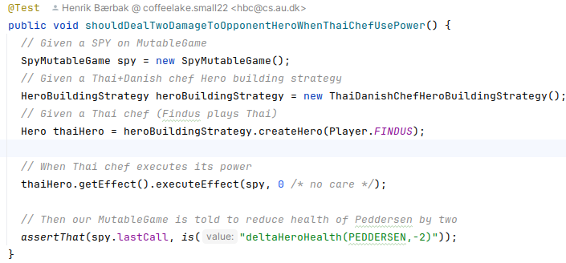
My Code
A Unit testing of Thai Chef, by using a Spy

Slide 7
My Spy
Is a simple ‘record last method call’

Slide 8
Discussion
Note how all these techniques combine to make it possible
Interface Segregation Principle + Role/Private interface
Game object can play both an “outward looking” and “inward looking” role
Game interface: outward looking what outsiders can do
MutableGame: inward looing what strategies can do
Program to an interface
MutableGame is an interface, and can be played by another object than the real implementation itself
Test Spy
The spy plays the MutableGame role, to test the hero power algorithm

Slide 9
Discussion
Unit Testing changes the GWT ‘mind set’
From
Given game; when execute power; then assert state of game
To
Given strategy; when execute power; then assert proper mutator method of ‘mutable game’ role is called with the proper parameters

Slide 10
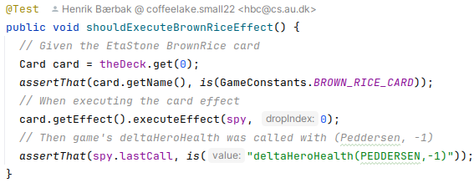
Benefit/Liability
Liabilities
You have to code the Spy
(Mock frameworks like ‘Mockito’ may reduce that effort)
Benefits
Much more evident tests
Much shorter tests

Slide 11
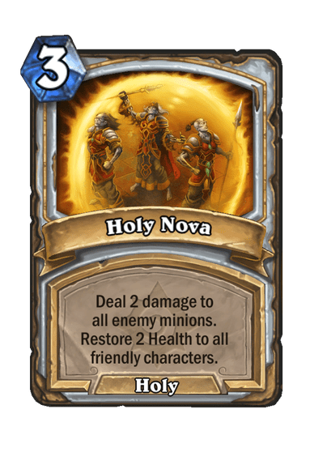
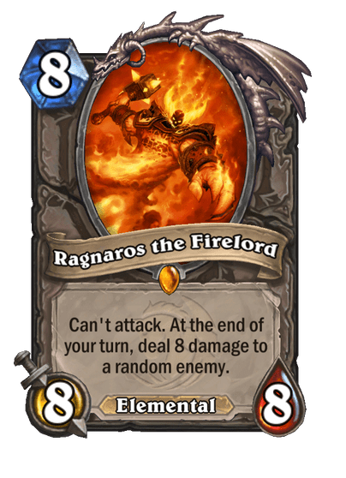
Outlook
EtaStone CardEffects
The core of HearthStone
Really nasty to do Integration Testing
Lots of code to bring card to the field, and test their effects ☹

Slide 12
Outlook
EtaStone
Unit testing is much easier
Given poke bowl, When executing effect, Then game’s ‘changeHealthOfHero(…)’ is called with parameter +2 on my own hero

